Slide 1
Finding the holy grail - a simple way to calculate all mixtures
Or how to frame any suspect: cherry-picking data
Charles Brenner, Ph.D.
Purveyor of forensic mathematics
DNA∙VIEW®
Senior Fellow, UC Berkeley Human Rights
charles@dna-view.com
http://dna-view.com
F10 CBrenner
Feb 20, Thu 1:30-1:45
Jurisprudence
2020 AAFS Anaheim
Notes:
Comment – The case in which I participated is used only as an example.
The talk isn’t about that case, not about what happened or whether the verdict was correct. (I don’t know).
Prolific Florida DNA consultant Dr. Kevin McElfresh employs as LR a number which he calculates in very simple way.
If also correct, the method would achieve the “simple yet valid” holy grail of mixture analysis.
It’s obviously, and dangerously, wrong.

Slide 2
Outline
DNA tradition: objective, scientific, numbers
  (2009 National Research Council report)
Case example: Simplified mixture analysis.
  Math by bluster
Epidemic in Florida
Miscarriages of justice
Notes:
The 2009 NRC report praised the practice of forensic DNA, especially in comparison with the other forensic science modalities.
Experts in fingerprint, hair, or even bite mark would testify that a similarity constituted very strong, even certain, evidence of identity.
Eventually it became clear that in effect the expert culture was to quantify strength of evidence intuitively based on personal experience.
Accumulation of examples and studies showing that expert intuition exaggerates, errs, and works by confirmation bias.
DNA escaped the same bad reputation because it quantifies.
DNA measures strength-of-evidence with the likelihood ratio (LR), a number with a real, appropriate, and scientific meaning.
Reporting that number distinguishes DNA evidence from malarkey.

Slide 3
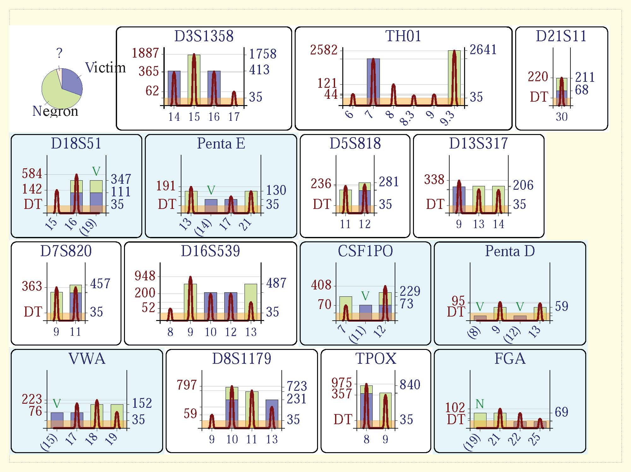
Use “informative” (prosecution-friendly) loci (white panels).
Discard “uninformative” (suspect allele missing )
☺ Simplifies calculation
☹ Frames the suspect
N
DNA evidence
“LR=117000” connecting Negron with murder Victim
N
N
Notes:
Mixture evidence from the case
McElfresh defines “informative” as “all alleles expected per prosecution hypothesis (i.e. suspect and victim) are present”
Perhaps the thinking is that they’re informative of what you think you already know. Confirmation bias.
“Informative” panels are analogous to witnesses favorable to the prosecution; tinted panels to alibi witnesses.
I disagree with his testimony that the tinted panel evidence, if calculated, would be further prosecution-favorable evidence.
If that were right, DNA could never exculpate anybody!

Slide 4
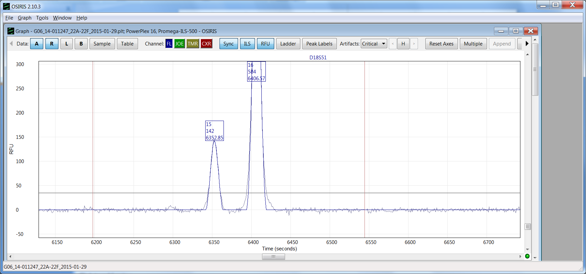
Close-up of strongest evidence that N’s DNA not in fingernail mixture – wrongly ignored by prosecution’s analysis.
Locus D18S51
of fingernail mixture
N has #16 and #19 at this locus.
Mixture shows no hint of #19.
Obvious explanation: he wasn’t there.
Unlikely explanation: total dropout .
Strong evidence N not there.
Prosecution’s DNA expert ignored data, like this locus, that favor the defendant.
#16
#19 posn
6568
#15
N
N?
35 rfu
0 rfu
Nothing!

Slide 5
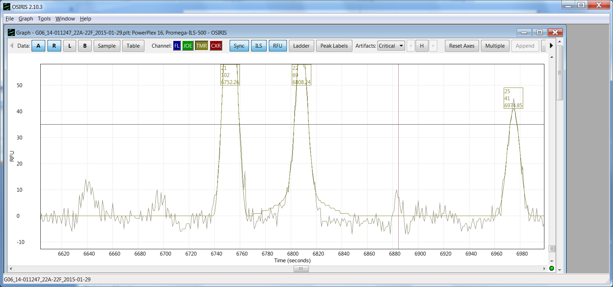
Another locus with similar story
Hint of signal at #19 position.
It’s faint: 11rfu is sub-threshold and 9x fainter than #21.
And misshapen (uncharacteristic of a real allele)
Locus FGA
of fingernail mixture
#21
102rfu
#19
6641
#22
#20
6696
#19 posn
#20 posn
35 rfu
#25
0 rfu
N?
N

Slide 6
Evidence changes your opinion
Pre-DNA likelihood X is guilty. Subjective opinion of juror.
Post-DNA likelihood X is guilty. (Logically adjusted opinion)
Scientific (objective) strength of DNA evidence vs X
Likelihood Ratio = 10000
1/100000
1/10000
1/1000
1%
10%
50%
90%
99%
99.9%
Probability X is guilty

Slide 7
Pieces of the fingernail DNA evidence
Your pre-DNA opinion
Combined evidence strength = 117,000
(Prosection’s evidence & calculation)
D16
5.7
D8
8.7
TH01
1.9
D7
6.7
D13
23.2
TPOX
3.7
D5
2.2
Net evidence?
D18
1/10000 ?
FGA
1/100 ?
Post-DNA
Negative evidence omitted by prosecution⌈
smaller
larger
Probability N’s DNA included
1%
10%
50%
90%
99%
(Actual suspect)

Slide 8
Fingernail DNA evidence; suspect=Brenner
Your pre-DNA opinion
Combined evidence strength per
prosection’s “ignore alibi” method
D3
5.7
TH01
1.9
D16
6.7
TPOX
3.7
Post-DNA
…
D13
D5
D18
FGA
Combined evidence strength? Negative?
smaller
larger
Probability Brenner’s DNA included
1%
10%
50%
90%
99%
(real killer?)
Notes:
The method will find positive evidence – LR>1 – for virtually anyone, and never LR<1.
The murder was 30 years ago. Where was I at the time?

Slide 9

I don’t recall
Many a man has dated his ruin from
some murder or other that perhaps he
thought little of at the time.
Thomas De Quincey
(Murder Considered as one of the Fine Arts, II)

Slide 10

Conclusion
Mixture analysis is difficult.
Shortcuts are tempting.
Honest shortcut: “Looks guilty to me. Can’t put a number on it.”
  Not acceptable practice, but honest.
Not honest: Claim that all loci are evidence against any suspect.
  Calculate the easy loci.
  Testify that skipping others favors suspect.
There’s an active market for false testimony.
Notes:
Honest: It’s tempting, as an experienced DNA hand looking at mixture data and comparing it with a suspect profile, to make the judgement that the suspect contributed.
Stop there and you’re like the old-time hair-matching etc. experts – honest but dangerously unaware of your limitations.
Not honest: Add a patina of “science” with a calculation that lacks logical basis, thus disguising the subjectivity as objective.
Active market: Among 1000+ cases of DNA assessment by eyeball guesswork adorned by a meaningless number, I expect multiple convictions of factually innocent suspects.

